Slide 1
Managing Marketing Information
CHAPTER NO. 4
Notes:
1

Slide 2
ROAD MAP: Previewing the Concepts
Explain the importance of information to the company and its understanding of the marketplace.
Define the marketing information system and discuss its parts.
Outline the steps in the marketing research process.
Explain how companies analyze and distribute marketing information.
Discuss the special issues some marketing researchers face, including public policy and ethics issues.

Slide 3

The Importance of Information
Companies need information about their:
Customer needs
Marketing environment
Competition
Marketing managers do not need more information, they need better information.

Slide 4

Information Overload
“In this oh so overwhelming information age, it’s all too easy to be buried, burdened, and burned out by data overload.”

Slide 5
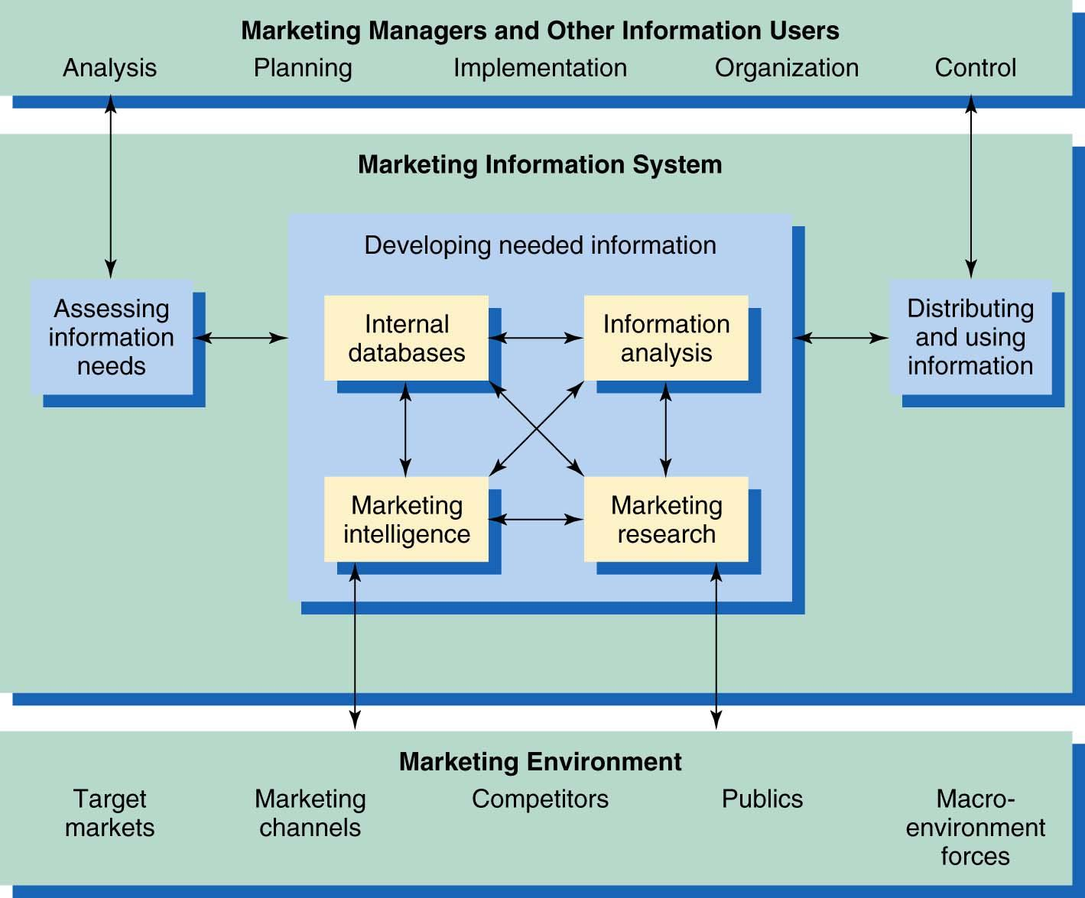
The Marketing Information System

Slide 6
Marketing Information System
An MIS consists of people, equipment, and procedures to gather, sort, analyze, evaluate, and distribute needed, timely, and accurate information to marketing decision makers.
The MIS helps managers to:
Assess Information Needs
Develop Needed Information
Distribute Information

Slide 7
Assessing Information Needs
A good MIS balances the information users would like against what they really need and what is feasible to offer.
Sometimes the company cannot provide the needed information because it is not available or due to MIS limitations.
Have to decide whether the benefits of more information are worth the costs.

Slide 8

Discussion Question
Provide some examples of marketing intelligence.
Notes:
8

Slide 9
Developing Marketing Information
Internal Databases: Electronic collections of information obtained from data sources within the company.
Marketing Intelligence: Systematic collection and analysis of publicly available information about competitors and developments in the marketing environment.
Marketing Research: Systematic design, collection, analysis, and reporting of data relevant to a specific marketing situation facing an organization.

Slide 10
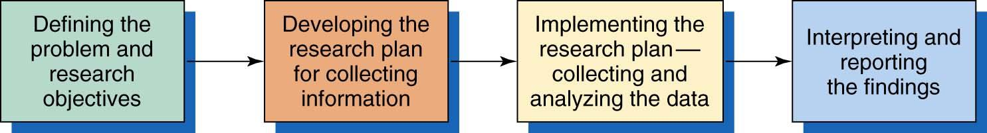
The Marketing Research Process
1
2
3
4
Notes:
10

Slide 11
Defining the Problem & Objectives
Exploratory
Research
Gather preliminary information
that will help define the problem
and suggest hypotheses.
Descriptive
Research
Describes things (e.g., market
potential for a product,
Demographics, and attitudes).
Causal
Research
Tests hypotheses about
cause-and-effect
relationships.

Slide 12
Developing the Research Plan
Includes:
Determining the exact information needed
Developing a plan for gathering it efficiently
Presenting the written plan to management
Outlines:
Sources of existing data
Specific research approaches
Contact methods
Sampling plans
Instruments for data collection

Slide 13
Gathering Secondary Data
Information that already exists somewhere
Internal databases
Commercial data services
Government sources
Available more quickly and at a lower cost than primary data
Must be relevant, accurate, current, and impartial

Slide 14
Gathering Secondary Data
Secondary data such as Foreign Trade Statistics, Industrial Statistics, Transport and Communication Statistics, social statistics, agriculture Statistics, Environment statistics, Literacy statistics, Income level, Pakistani Household surveys etc. are collected from the records of concerned Ministries/Departments.

Slide 15
Primary Data Collection
Consists of information collected for the specific purpose at hand.
Must be relevant, accurate, current, and unbiased.
Must determine:
Research approach
Contact methods
Sampling plan
Research instruments

Slide 16
Observational Research
The gathering of primary data by observing relevant people, actions, and situations.
Ethnographic research:
Observation in “natural environment”
Mechanical observation:
People meters
Checkout scanners

Slide 17


Observational Research
Fisher-Price set up an observation lab in which it could observe the reactions of little tots to new toys.

Slide 18
Survey Research
Most widely used method for primary data collection.
Approach best suited for gathering descriptive information.
Can gather information about people’s knowledge, attitudes, preferences, or buying behavior.

Slide 19
Experimental Research
Tries to explain cause-and-effect relationships.
Involves:
selecting matched groups of subjects,
giving different treatments,
controlling unrelated factors, and
checking differences in group responses.

Slide 20
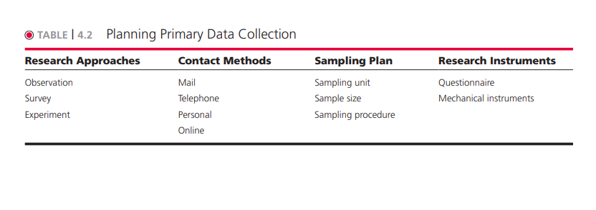
Primary Data Collection
Notes:
20

Slide 21
Choosing the Sample
Requires 3 Decisions:
Who is to be surveyed?
Sampling unit
How many people should be surveyed?
Sample size
How should the people in the sample be chosen?
Sampling procedure
Sample – segment of the population selected to represent the population as a whole.

Slide 22
Primary Data Collection
Research Instruments
Questionnaires
What questions to ask
Form of each question
Closed-ended
Open-ended
Wording
Ordering
Mechanical Devices
People Meters
Supermarket Scanners
Eye Cameras
Notes:
22

Slide 23
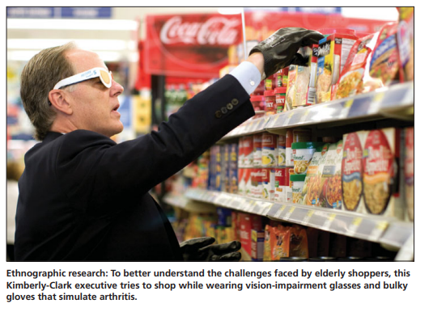

Slide 24
Implementing the Research Plan
Most Expensive & Subject to Error
Collecting the
Data
Processing the
Data
Research Plan
Analyzing the
Data
Notes:
24

Slide 25
Interpreting & Reporting Findings
Managers and researchers must work together when interpreting research results.
Step 1. Interpret the Findings
Step 2. Draw Conclusions
Step 3. Report to Management
Notes:
25

Slide 26
Analyzing & Using Marketing Information
Customer Relationship Management
Many companies utilize CRM
Capture customer information from all sources
Analyze it in depth
Apply the results to build stronger relationships.
Companies look for customer touch points.
CRM analysts develop data warehouses and use data mining techniques to find information out about customers.

Slide 27
Distributing and Using Marketing Information
Routine Information for Decision Making
Nonroutine Information for Special Situations
Information Must be Distributed
to the Right People at the Right Time
Intranets
Extranets
Notes:
27

